Slide 1
Update inputs and more

Slide 2
Agenda
Homework 1 Recap
Homework 2
Download Handler
Bookmarking
Notifications
Progress Bar
Values List
Updates/Observers

Slide 3
Homework 1 recap

Slide 4
Stats
Mean | 97.685
Median | 98.1
Std Dev | 2.073

Slide 5
Homework 2

Slide 6
Homework 2: UI and Visuals that talk to each other
Use plotly (with or without the aid of ggplot2) to create three (3) different kinds of figures and one (1) data table. Include at least three (3) types of inputs, one (1) functioning downloadButton() and one (1) observer in the server. On the server side your plots and tables must utilize the reactive function for any and all datasets.
Data Resources:
WPRDC: https://data.wprdc.org/
Data World: https://data.world/datasets/data
US Open Data: https://www.data.gov/
EU Open Data: http://data.europa.eu/euodp/en/data/
Just about any major US City

Slide 7
Download Handler

Slide 8
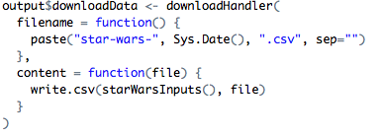
Download Handler
Downloads can be either a Button or a Link in the UI
The Handler is a function with two parts:
Filename: here as a paste function to include the date
Content: here calling the reactive data from starWarsInputs()
The file name, type or content can also be changed from any input

Slide 9
Bookmarking

Slide 10
What is bookmarking?
Bookmarking allows you to save application states so users can easily access their settings
Not all of your inputs have to be available, you can create a blacklist of inputs using the setBookmarkExclude() function
There are two methods of Bookmarking, Server and URL

Slide 11
Bookmarking
Server side
Remembers people’s settings using cookies
Specific button created for saving the state on the server side
States are saved on the server and loaded
URL Side
Translates URL into the input settings of your application
Either a button can be added to the UI or Shiny can dynamically update the URL so a user can bookmark it

Slide 12
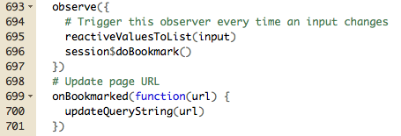
URL Bookmarking Example

Slide 13
onRestore()/onRestored()
Unless you specify something using either of these functions, all inputs stored will restore when loading an app with bookmarking
onRestore() can help implement some logic before restoring certain inputs, or save in a list to be used later.
onRestored() runs after the application has been restored. Can be used to send update to the user.

Slide 14
Notifications

Slide 15
Notifications
Notifications are good when your app makes a major change or runs into an error.
There are a few different colors of notifications:
"default" (gray)
"message" (blue)
"warning" (yellow)
"error" (red)
You can determine if users can close the window and for how long it is active.

Slide 16
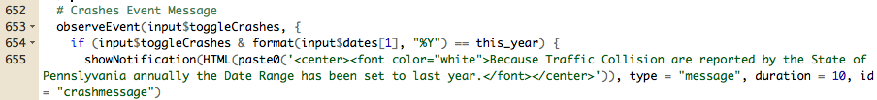
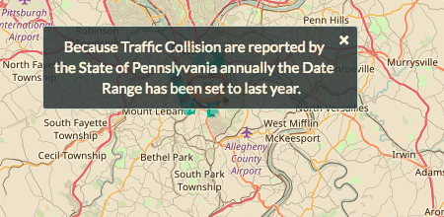
Notification Example (with custom css)

Slide 17
Progress Bars

Slide 18
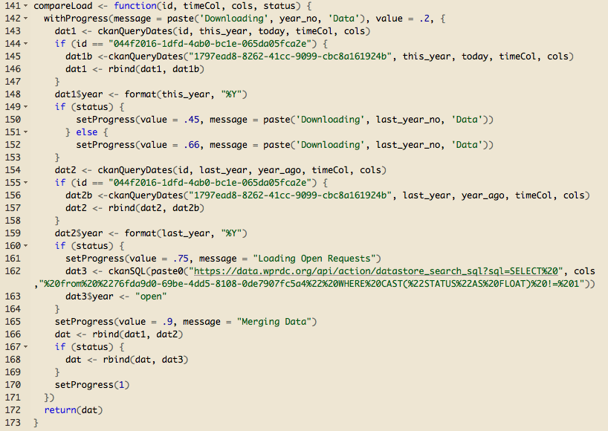
Progress Bar Example

Slide 19
Values List

Slide 20

Value Lists are an alternative way to store Data
Instead of using reactive which stores as a function, value lists can be updated on the fly in either reactive() or an observe()/observeEvent() function.
reactiveValues() is a list that overwrites and are held constant across all of the instances of its use in the app
Change the values by saving to the name you want like this:

Slide 21

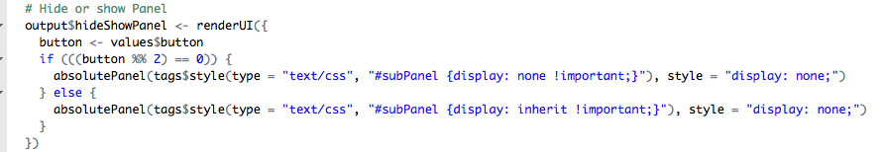
Use case: sync multiple action Buttons
By using the observer event we can link 3 action buttons (edit, cancel & submit) together which all impact the UI or data in a similar way

Slide 22
Updates

Slide 23
Updates & Observe Events
Any time you wish to update part of your UI you will need to include an event observer.
Here you will be observing an input that your user can interact with
Observers can be done in one of two ways. Event observers or generic observer function
observeEvent() when you are observing a particular input
observe() works if you want to observe multiple things, or non-input based object such as the output or content of a reactive function.
Alternative to renderUI()

Slide 24
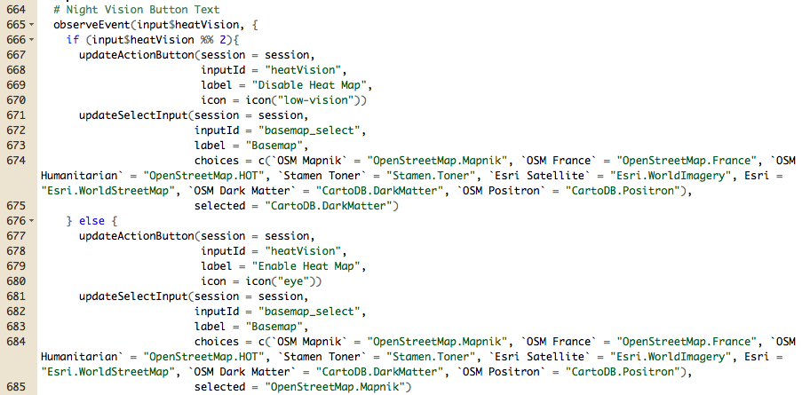

Slide 25
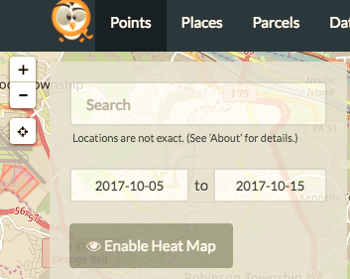
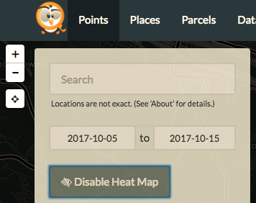
Before: After:

Slide 26
Expanding Observers with ShinyJS

Slide 27
What is shinyjs?
“shinyjs lets you perform common useful JavaScript operations in Shiny apps that will greatly improve your apps without having to know any JavaScript. Examples include: hiding an element, disabling an input, resetting an input back to its original value, delaying code execution by a few seconds, and many more useful functions for both the end user and the developer. shinyjs can also be used to easily call your own custom JavaScript functions from R.”
From github page: https://github.com/daattali/shinyjs

Slide 28
Useful functions
disable()/enable() – disable/enable a UI element to control what users can do.
click() – simulate a click on a UI element
alert() – send a message through the user’s browser
onclick()/onevent() – run some code when a UI element is clicked, or an event happens such as a key press or the mouse hovers over something.
show(), hide(), toggle() – Display or hide a UI element (with animation)

Slide 29
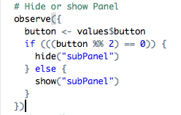
Before shinyjs
After shinyjs

